Slide 1


Community energy in your area
School workshop
February 2026
This resource has been developed by the Centre for Sustainable Energy as part of the Future Energy Landscapes project.
Notes:
This workshop is designed for KS2-KS4 students with some knowledge of climate change. If your students need more information about climate change or energy, please see our Energy Matters resources: www.cse.org.uk/resource/teaching-climate-and-energy-educational-resources/
To run this workshop, you will need either one giant map of your local area or several A3 printed maps, digital copies of maps of your local area inserted into the relevant slides, some green, yellow and pink post it notes, and some sticky dots.

Slide 2

Your Future
Purpose: Explore community-owned renewable energy in your area and build a local consensus on the type, size and potential location of renewable technologies that might be acceptable (if any).
Aims:
Map the local landscape, considering areas that are special or disliked
Reflect on energy use in the local landscape
Consider types of renewable energy that might be acceptable within the area from a selection of feasible options
Choose locations where these technologies might be located
Understand how and why it is important that you are part of the decision-making!
Notes:
We want to talk about energy and why it is important for young people to be part of the discussion and decision making

Slide 3

What is climate change?
“Climate change refers to long-term shifts in temperatures and weather patterns. Since the 1800s, human activities have been the main driver of climate change, primarily due to the burning of fossil fuels like coal, oil and gas.”
United Nations
Notes:
ASK THE ROOM: What is climate change?
CLICK THE SLIDE: UN definition will appear

Slide 4
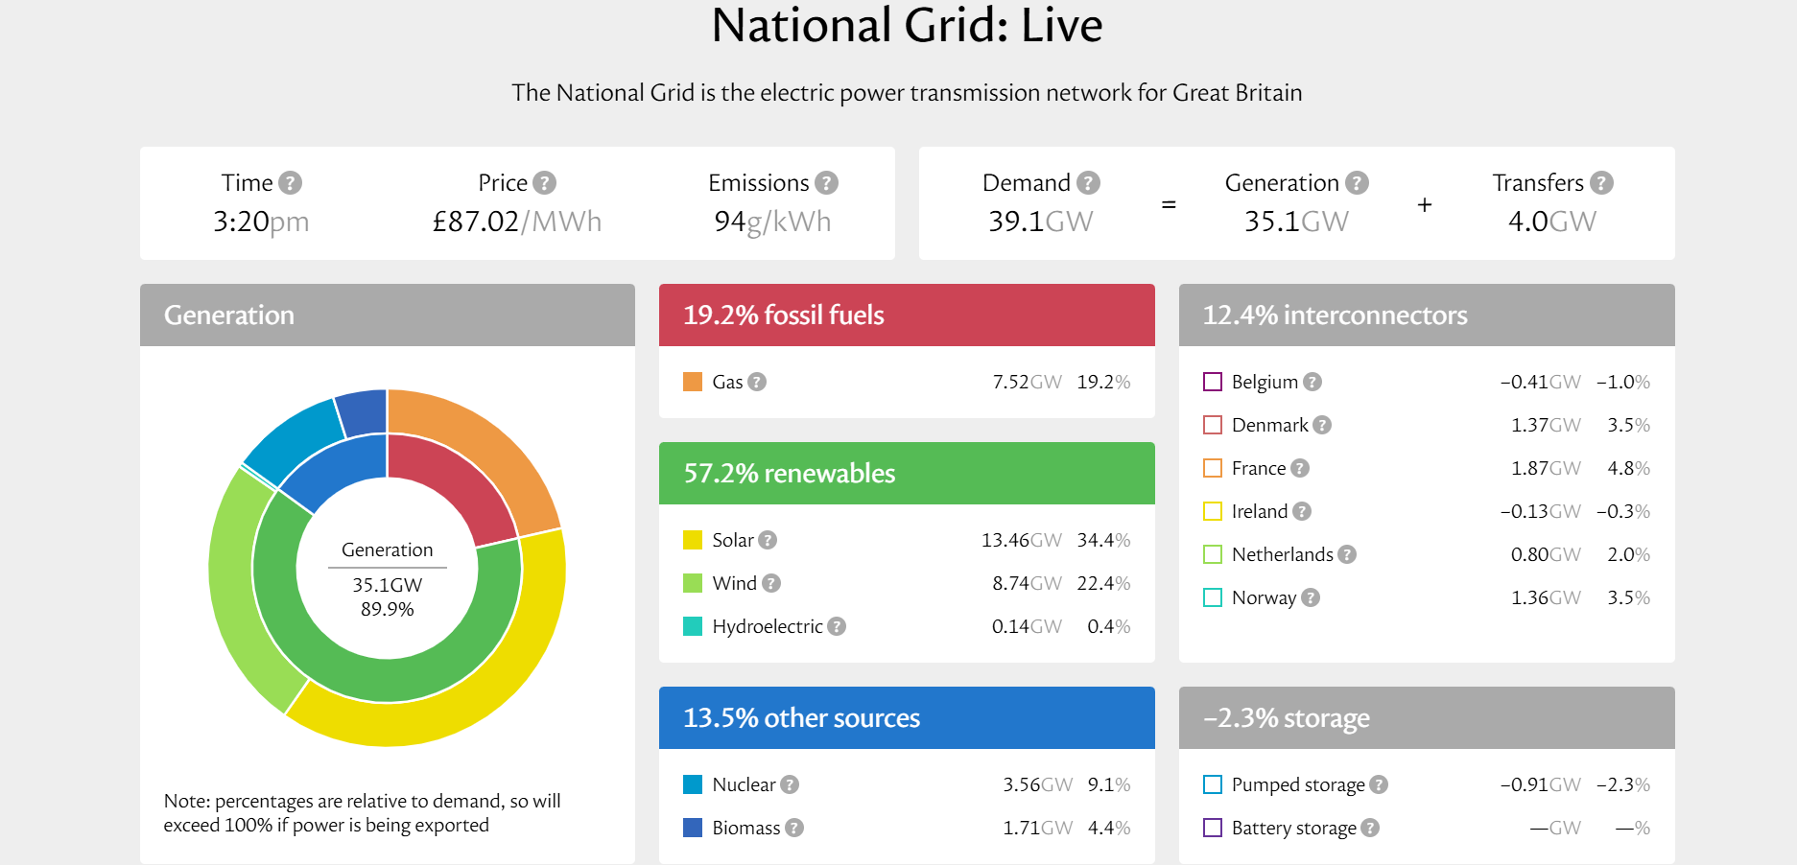
Where does the UK get its energy from?
Notes:
ASK THE ROOM: What energy generation infrastructure is in the landscape around you?
For the next section, we’re going to think about how YOU could have more renewable energy in the area around your school.
This slide can be updated with screenshots from grid.iamkate.com

Slide 5
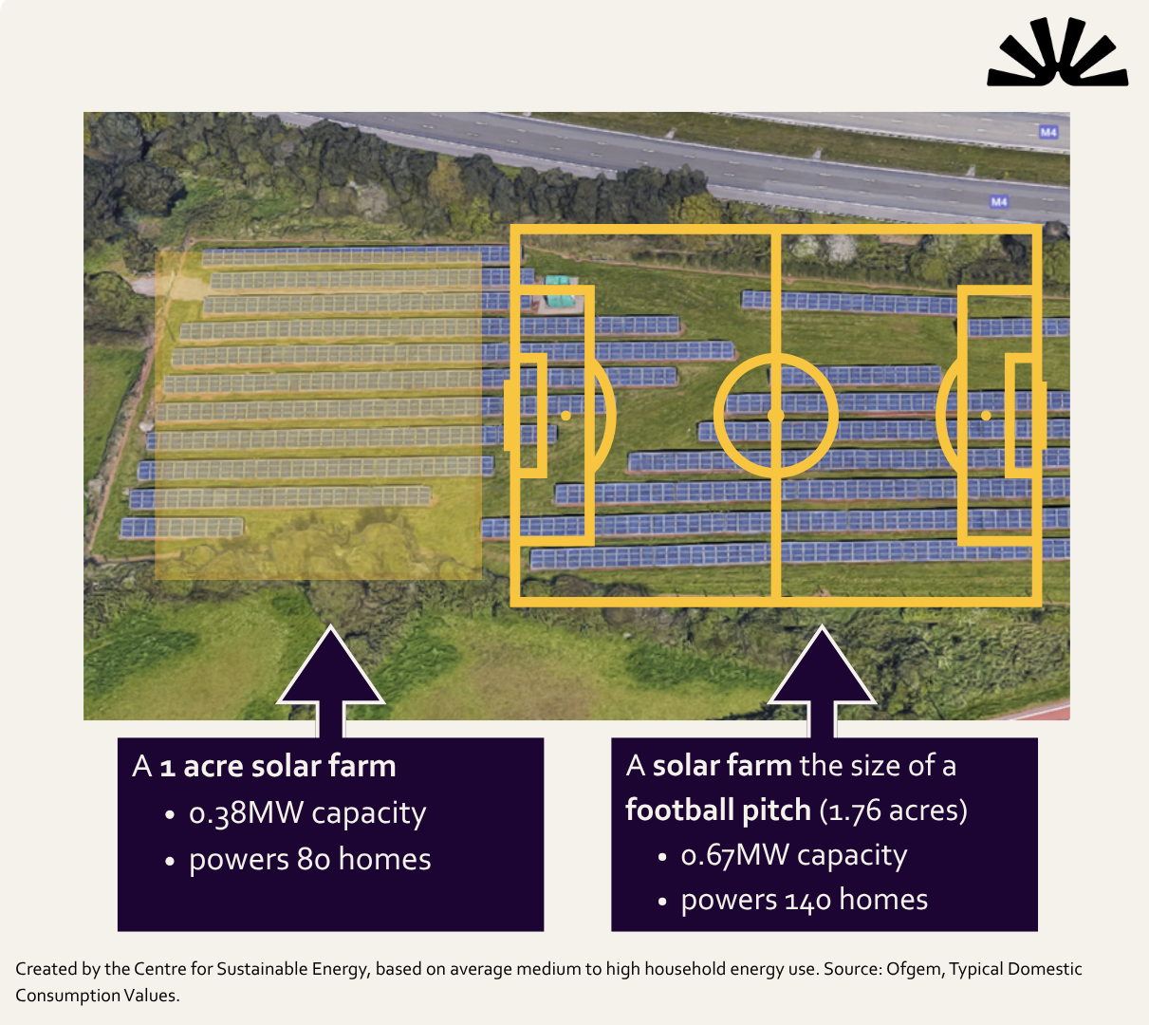
Solar farm
Interconnected panels arranged in rows, absorb sunlight and convert it into electricity.
Land requirements higher than wind.
Can provide opportunity for improving biodiversity and animal grazing.
Notes:
A major source of renewable energy is solar panels.
Solar panels turn light energy into electricity, so they need to be built where sunlight can hit the panels directly. They don’t work if they are shaded by trees or buildings. The best place for a solar panel is facing South, because that direction gets the most sunlight over the year.
One roof of solar panels (on the south side!) can power most of the electricity for 1 home. A solar farm the size of a football pitch, like in this photo, would power about 51 homes. Solar farms can be put on fields like this, or they can go on roofs of big buildings.
Currently the amount of land occupied by solar farms is between 15,580 and 17,364 hectares – this is around 0.06% to 0.07% of the total UK land area. If we continue to deploy solar in the same proportions – the proportion on rooftop in relation to solar farms on the ground - as we have been doing, then a total of between 0.22% to 0.39% of total UK land (or 0.45% to 0.82% of agricultural land) might be needed for solar farms in the future to meet our energy and decarbonisation objectives. This figure includes existing solar farms.

Slide 6
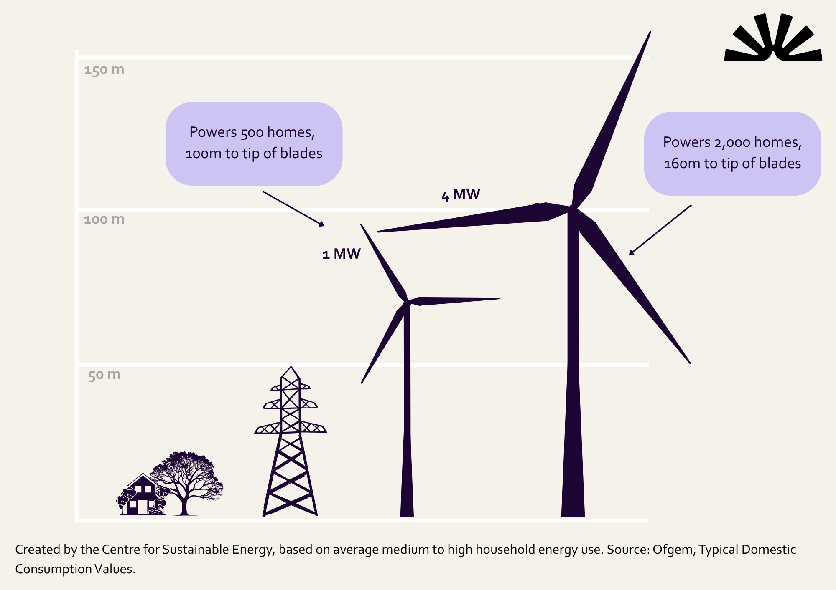
Wind turbine
Blades rotate by the wind and turn kinetic (movement) energy into electrical energy.
More visible than solar, but lower land take.
Produce significantly more electricity the taller and larger they are.
Average wind turbine height in UK is 94 metres but they can be up to 150 metres.
Notes:
Wind turbines use the energy of the wind to make electricity. The blades turn in the wind and spin a turbine, which creates an electric charge. So, they’re great in windy places! Like on hills. The first wind turbine for electricity was built in Scotland in 1887. Before that wind energy was often used by windmills to grind grain.
Wind turbines come in many sizes, and a group of turbines is called a wind farm. This diagram shows you how big wind turbines can be built compared to the height of a house and a power line. Wind turbines that are 100 meters tall power about 500 homes. Very large wind turbines are 150 meters tall!! Turbines this large can power over 2000 homes.

Slide 7
Who builds renewable energy?
Engineers
Town planners.
Businesses.
Community energy groups.
Notes:
It is some people’s jobs to decide where and when to build renewable energy. If you have ever seen a wind turbine or a solar panel, people with these jobs will have been involved in coming up with the idea, getting permission, designing it, paying for it or building it. Does anyone have suggestions of what jobs might build renewable energy?
CLICK
Engineers. Does anyone know someone who is an engineer?
Engineers test machines, products and new ways of doing things.
They try to solve problems and invent solutions using maths and science, including how we can make enough clean energy.
CLICK
Town planners. Does anyone know someone who is a town planner? A parent or parent’s friend maybe? (Not expecting hands here…)
Town planners design our cities, towns and villages.
They try to make sure everyone can access housing, parks, hospitals, schools, shops, and energy, no matter where they live.
CLICK
Businesses.
Business people can build renewable energy sources and sell the energy for a profit – to make money. Often these businesses might be energy companies who already own and sell fossil fuel energy sources. Businesses can install or build renewables on their own buildings or on new areas.
CLICK
Community energy groups
Groups of local people work together to fundraise for renewables that benefit the community, such as through selling cheaper electricity to community buildings, and keeping them open!

Slide 8

What is community energy?

Slide 9
There are lots of different models
Although many community energy projects follow a similar path:
Identify opportunity.
Raise money for construction, including selling shares.
Landowner receives rent; shareholders receive interest.
Profits are reinvested locally.
Money stays in community, carbon emissions are reduced.
Notes:
There's no single model, but many community energy projects follow a similar path. A local not-for-profit identifies an opportunity, perhaps a suitable site for a small solar farm. They raise money, often by selling shares to local people, and use that to fund construction. The landowner receives rent; shareholders receive a return on their investment.
Surplus profits don't disappear into a head office. They're reinvested locally, and get used to improve or benefit the local community. The renewable energy reduces carbon emissions. The money stays put.

Slide 10
Possible benefits from community owned schemes
Community benefit fund for local projects
Opportunities to increase biodiversity
Investment opportunities for local people, keeping profits in the community
Lower cost electricity for local people possible in some areas
Revenues from renewables used locally
Reduction in air pollution and carbon emissions
Notes:
The energy source being owned by the community rather than a big business means that the community can decide what to do with the money the energy makes. There are lots of options for this!
Lower cost electricity for local people possible in some areas – several areas are doing this, but it depends on the grid connection. More community energy groups are trying to get a model for doing this that works more easily, so it’s being explored more.

Slide 11
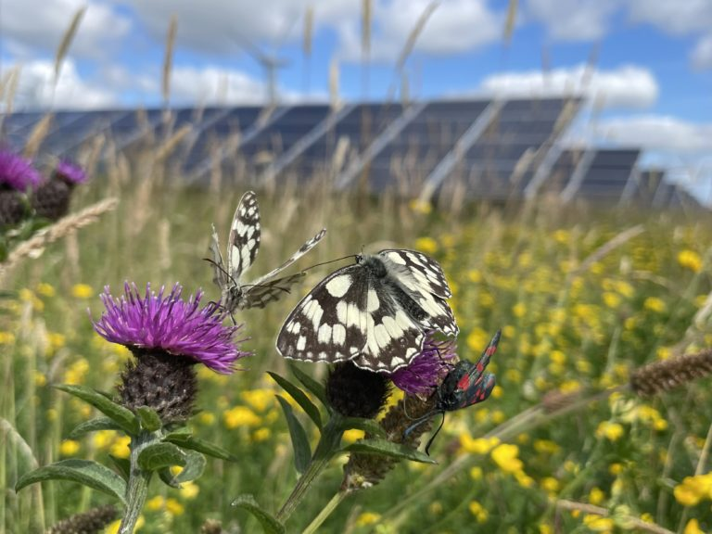
Example: Westmill Solar Cooperative
1,600 members, helped fund solar farm which powers 1,200 homes per year.
Generated £1million in grants for community groups since 2020.
Flock of 40 native sheep graze between panels.
Reseeded with local plant species for healthier soils and more insects and birds.
Notes:
Energy owned by the people
1,600 people members who helped fund the local solar farm. They vote on decisions, get discounts on their bills and are paid interest dividends.
They own the solar farm.
30 acres (17 football fields) powers 1,200 homes a year.
Has generated almost £1 million in grants for community groups since 2020.
Biodiversity at Westmill Solar Park
Herd of 40 sheep graze between the panels. They are sheep native to the Westmill area.
Reseeded with a mix of local plant species. Increased biodiversity, meaning healthier soils, more insects and birds.
The sheep help maintain biodiversity by disturbing the soil and eating plants that aren’t helpful for the ecosystem.
More info: westmillenergy.coop

Slide 12
Map activity
Write on some sticky notes and put them onto the map.
Use different colours for different prompts.
One specific area that is special (and why)
One specific area that you dislike, or think isn’t special (and why)
One idea for community benefit that you would like to see.
Notes:
Ideally, make one giant map of your local area for all students to add their sticky notes to. Otherwise, print A3 and hand out to groups of students. Give out a green, pink and yellow post it note to each student.
SHOW OF HANDS: Who lives in inside the boundary of this map? Who lives outside of it? Which area do you live in?
We’d like to know one thing that’s special, one thing you dislike and one thing you would like to see funded by a community benefit pot. Stick each sticky note on the right area of the big map.
Think about an area that’s particularly beautiful, an area you enjoy spending time, a view from your house, where you walk your dog, etc.
Think about areas you never really go, that are a bit noisy, that are a bit run down.
Think about how you think the area could be improved with a bit of funding.

Slide 13
Community energy in your area

Slide 14
Activity: Community energy in my area
In your groups discuss:
How acceptable is the idea of a community-owned solar farm or a wind turbine in your area to you? What makes you feel more negative or more positive about one?
Add sticky dots to areas on the map you’d be interested in finding about more about.
Notes:
Your map will show you where renewable energy could go. Your task is to decide if you would want to see a community-owned wind turbine or solar farm built in your area, and if so, where it could go.

Slide 15
Wind turbines
Notes:
Insert a map of your local area here, ideally including some possible wind turbine sites.
Give a certain amount of sticky dots – e.g. four green, four red per group. Each group discusses where would be best (green sticky dot) and where wouldn’t work (red sticky dot). This activity can either run on the one giant map or on smaller group maps.

Slide 16
Solar farms
Notes:
Insert a map of your local area here, ideally including some possible solar farm sites.
Give a certain amount of sticky dots – e.g. four green, four red per group. Each group discusses where would be best (green sticky dot) and where wouldn’t work (red sticky dot). This activity can either run on the one giant map or on smaller group maps.

Slide 17
How much energy would your choices make?
1 x 150m wind turbine:
2,148 homes
XX% homes in XX*
1 x 5MW solar farm:
1,041 homes
XX% homes in XX*
*With current policy the electricity will likely be fed into the grid. This figure is to help you understand the amount generated.
Notes:
Insert the name of your local area and the percentage of homes each energy source could power. You can find information on the total number of homes in an area here: https://www.ons.gov.uk/peoplepopulationandcommunity/populationandmigration/populationestimates/adhocs/2441parishpopulationestimatesformid2021basedonbestfittingofoutputareastoparishes

Slide 18
What have you learnt?
Engineers, town planners, companies and local people can all build renewable energy.
When local people build community-owned renewable energy, this can help give your community money for improvement projects.
You can also choose the right technology and location for your area.
Notes:
Also look at outputs from the map and gather class consensus.

Slide 19
What have we learnt?
Area in XX that is special:
Area in XX that is disliked:
Young people would like to see insert notes here based on session discussion
Solar area with most votes = ?
Wind area with most votes = ?
Notes:
Gather learnings from post it notes and from sticky dot voting and use this slide as a record.

Slide 20


With thanks to
This resource has been developed with thanks to funding from the Energy Industry Voluntary Redress Scheme and the National Lottery’s Climate Action Fund.

Slide 21


Final page (1)
We’re a charity (298740) supporting people and organisations across the UK to tackle the climate emergency and end the suffering caused by cold homes.
cse.org.uk
Notes:
An end card. A rare case of centred text!

