Slide 1



Creating neighbourhood plan policy objectives for a zero carbon future
Neighbourhood planning for a safe and stable climate

Slide 2

Purpose of this workshop is to:
Understand the full significance of climate change and scale of changes we need to take as a society.
Consider how these relate to your community and how your neighbourhood plan might contribute.
Consider how these relate to your community and how your neighbourhood plan might contribute.
Notes:
Explain the purpose of the workshop

Slide 3

Workshop outputs:
An initial list of high level policy objectives for possible inclusion within your neighbourhood plan.
A list of possible community actions and initiatives which might sit alongside your neighbourhood plan.
An action plan, setting out next steps and allocating actions to individuals within your group and dates.
Notes:
And the outputs
Explain that the workshop outputs will be used in consultations with the wider community.

Slide 4

6:30 | Arrivals – and tea and coffee
7:00 | Welcome, introduction and ground rules
7:10 | Presentation – Context of climate change
7:25 | Workshop – Policies and objectives
8:30 | Coffee & tea break (and reflection opportunity)
8:40 | Finalisation of objectives and what can be done through planning
8:50 | Agreeing next steps
9:00 | Close
Notes:
Take attendees briefly through the timings. Explain that a main task as facilitator is to keep us on time, and that from time to time in the workshop you might need to move them onto the next task, so that they get home on time!

Slide 5

Neighbourhood Plan
Once adopted, neighbourhood plan policies have the same importance as your council’s planning policies.
  The basic conditions are that the neighbourhood plan:
  Contributes to the achievement of sustainable development.
  Is in general conformity with the strategic policies contained in the development plan.
  Does not breach EU obligations.
Notes:
Neighbourhood plans enable communities to set their own planning policies to control development which happens within their areas. Once adopted, these policies have the same importance as those set by your council.
There are no particular requirements that neighbourhood plans have to include, but they do have to comply with some basic conditions.
Neighbourhood plans are therefore a huge opportunity for communities to develop policies and strategies addressing climate change, to add to or fill gaps in what local council’s are already doing.

Slide 6
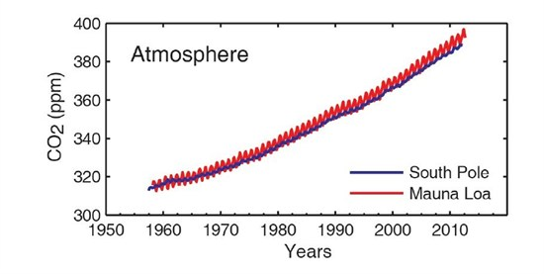
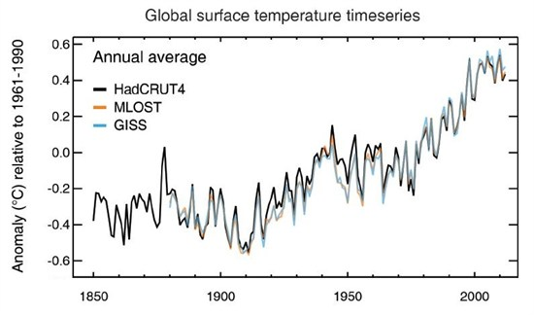
Why a “sustainable” Neighbourhood Plan?
Link: http://bit.ly/1C0wE5v
Notes:
The graph on the left shows rising levels of carbon dioxide in our atmosphere, and the graph on the right shows rising temperatures.
So far there has been approximately a 1 degree warming globally since pre-industrial times.
In 2013 global CO2 levels passed 400 ppm. Levels of CO2 probably have not exceeded 400 ppm for 2 to 3 million years at which point the air temperature was up to 8 degrees C (14 degrees F) higher than today.
Sources:
www.worldviewofglobalwarming.org/pages/maunaloa.php
www.carbonbrief.org/blog/2013/09/ipcc-six-graphs-that-explain-how-the-climate-is-changing/

Slide 7
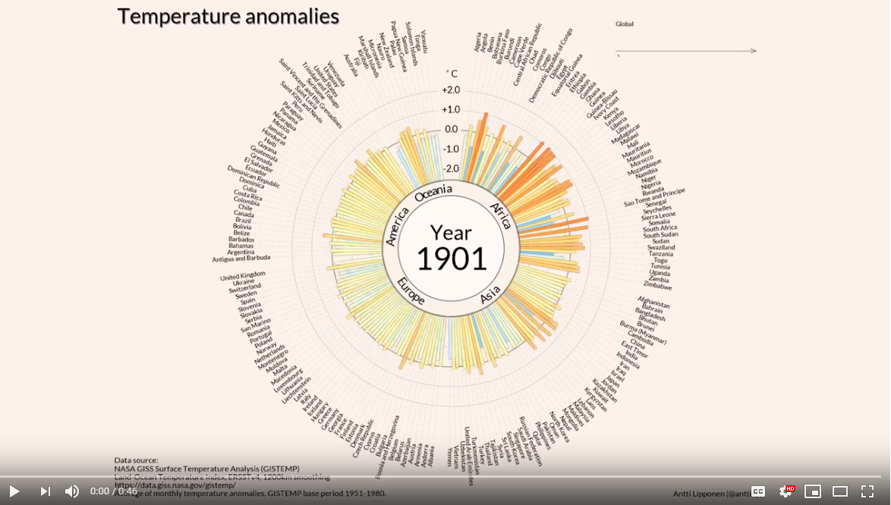
www.youtube.com/watch?v=-yIHxOui9nQ
Notes:
{PLAY THIS VIDEO FROM YOUTUBE}
This animation from Carbon Brief shows global temperature anomalies since the year 1900. Peaks in red are heat-waves and increases in temperature beyond normal expectations. Peaks in blue are cold snaps beyond normal expectations.

Slide 8
When was the hottest year
on record globally?
Link: http://bit.ly/1C0wE5v
Notes:
Ask this question to the group and wait for suggestions. What about the hottest year before that?
- The hottest year on record was - 2016
- previous hottest year on record – 2015
previous hottest year on record - 2017
previous hottest year on record - 2018
previous hottest year on record - 2014
Globally, The last 5 years have been the hottest years on record.
16 of the 17 warmest years have occurred since 2000
https://www.climatecentral.org/gallery/graphics/the-10-hottest-global-years-on-record
https://www.nytimes.com/2017/01/18/science/earth-highest-temperature-record.html

Slide 9
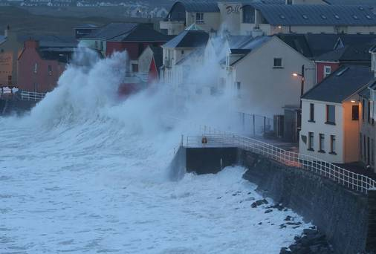
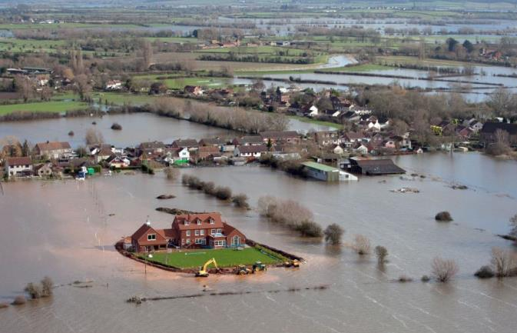
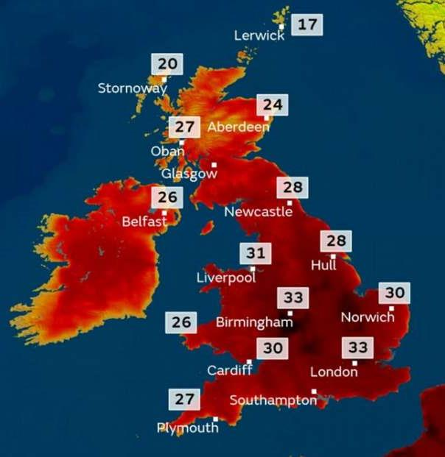
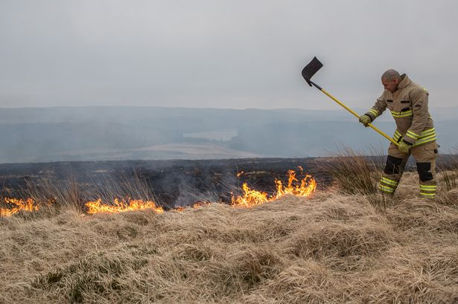
UK climate impacts
Notes:
The predictions are that climate change will result in more extreme weather events: with more severe storms, flooding and heat waves, and wetter winters and drier summers, and we’re already seeing this each year.
In a business as usual (high emission) scenario, Britain could experience
summers as much as 5°C hotter by 2070 as a result of climate change,
winters could be up to 4.2C warmer,
a 50% chance of summers being as consistently hot as the 2018 summer by 2050.
47% decrease in average summer rainfall by 2070, and up to 35 per cent more rain in winter⁸.
sea level rise of up to 1.15 metres in London by 2100, leaving the UK coastline unrecognisable.
UK Climate Projections 2018 - https://deframedia.blog.gov.uk/2018/11/26/environment-secretary-launches-latest-uk-climate-projections-at-the-science-museum/

Slide 10
Extreme weather events in the UK
2003 | Heatwave – 35,000 deaths in Europe (2000 in UK) | 2012 | Drought followed by record rainfall and floods Landslides and fatal cliff collapses on SW coast
2004 | Devastating Boscastle Floods – evacuations by helicopter | 2013 | Heatwave, winter storms, dangerous sea conditions (fatality) and coastal flooding, thousands evacuated on east coast due to storm surge fears , flooding across southern England
2005 | Flooding in Cumbria & Carlisle | 2014 | Storms, flooding in Oxford & Somerset, Dawlish railway line washed away
2007 | Drought, Floods in Oxford and Gloucestershire | 2015 | Winter floods in Leeds, York, Carlisle, Cumbria, Hebden Bridge and Calder valley
2007 | Flooding across central England (Tewkesbury) and Scotland, heatwave | 2016 | Storm Desmond, Storm Eva, Storm Frank, winter Floods
2008 | Flooding in south Wales and north-east England | 2017 | Floods in Lancashire (70 people rescued) and Cornwall (Coverack) – homes evacuated
2009 | Flooding in Lake District and Cockermouth (fatal bridge collapse), Disruptive snow falls | 2018 | Heatwave (863 deaths in UK), Saddleworth Moor wildfire, ‘Beast from the east’
2010 | Flooding in Cornwall, snow and Ice. Coldest December for 100 years | 2019 | Hottest winter day on record – 21° in February, hottest summer day on record – 38.1°, Floods, hundreds evacuated due to near collapse of Whalley Bridge reservoir
Notes:
This slide summarises some of the extreme weather events that have occurred in the uk since 2003, many of which you’ll recall, in particular the floods around the country. It’s not possible to say that individual weather events are caused by climate change, but it makes events like this much more likely and their severity worse.
Talk the group through any of the events you recall personally, and ask whether anyone else recalls any of these events. You don’t need to cover them all.
https://www.metoffice.gov.uk/weather/learn-about/past-uk-weather-events#y2008
https://www.newscientist.com/article/dn4259-the-2003-european-heatwave-caused-35000-deaths/
https://assets.publishing.service.gov.uk/government/uploads/system/uploads/attachment_data/file/821711/PHE_heatwave_report_2018.pdf
https://www.metoffice.gov.uk/weather/learn-about/weather/case-studies/boscastle

Slide 11
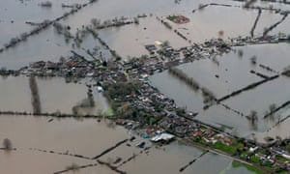
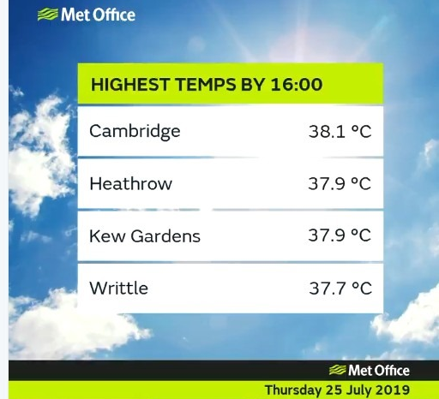
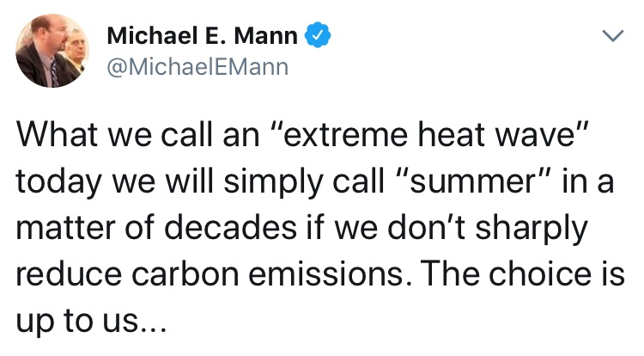
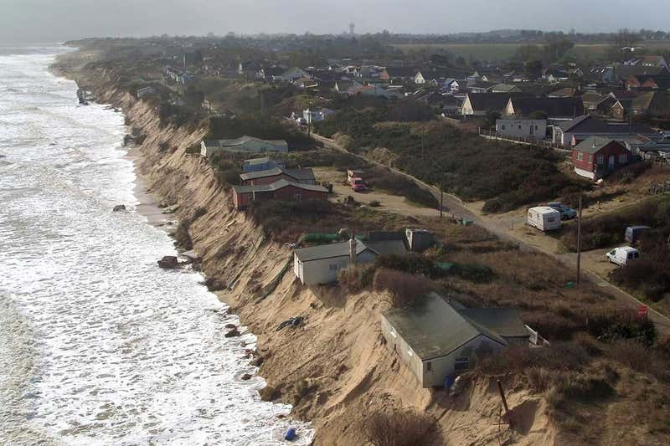
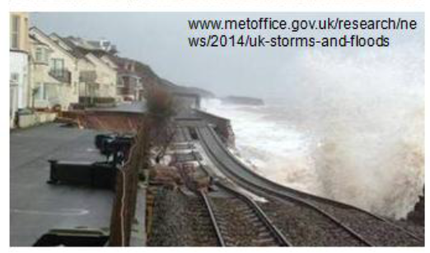
https://www.theguardian.com/uk-news/2014/feb/13/uk-floods-essential-guide
https://www.newscientist.com/article/2202190-some-uk-coastal-communities-may-have-to-move-because-of-climate-change/

Slide 12
International and UK legislation
Paris Climate Change Accord
Agreement to limit global temperatures increases “well below 2°C above pre-industrial levels, ideally 1.5 °C”
UK Climate Change Act
80% reduction in greenhouse gas emissions by 2050, updated summer 2019 to 100% cut by 2050
Notes:
There are two pieces of legislation around climate change:
The Paris Climate Accord commits nations to keep global average temperatures “well below 2°C above pre-industrial levels, to pursue efforts to limit the temperature increase to 1.5 °C”, leading to no net increases in carbon emissions in the second half of this century.
Climate Change Act – this commits the uk to reduce CO2 emissions by 100% by 2050 (from 1990 baseline) updated from an 80% cut this summer. It sets in place transitional targets to achieve on the way to the overall target and a formal review mechanism.

Slide 13
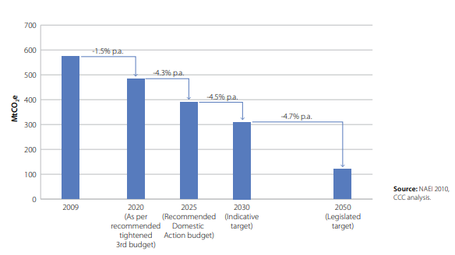
  Climate Change Act 2008 - commitment to reduce CO₂ emissions by 80% by 2050
Notes:
This bar chart shows the legislated carbon reduction targets from the Climate Change Act, stepping down emissions from uk in 5-yearly increments to 2050. An independent committee (the Committee on Climate Change) reports regularly on progress and holds government to account to achieve these cuts.

Slide 14
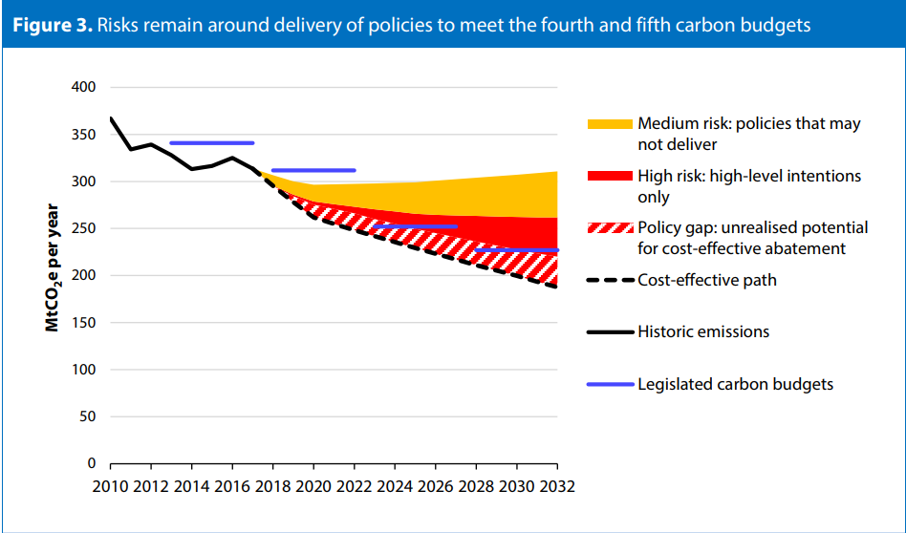
  “The UK is not on course to meet the legally binding fourth and fifth carbon budgets.” Committee on climate change - 2018 Progress Report to Parliament
  www.theccc.org.uk/wp-content/uploads/2018/06/CCC-2018-Progress-Report-to-Parliament.pdf
Notes:
This is an excerpt from the 2018 progress report to parliament, the Committee on Climate Change – It shows the likelihood of meeting our interim carbon reduction targets towards an overall 80% reduction. There’s no need to go into detail, suffice to say we’re not on course to meet an 80% reduction by 2050.

Slide 15
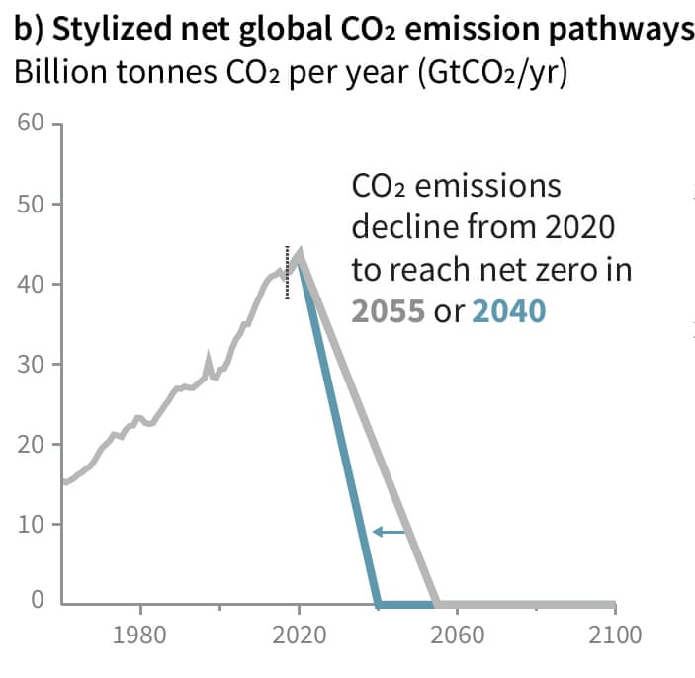
IPPC report 2018 - Global warming of 1.5°C
There are only 12 years to keep global warming below 1.5°C.
Beyond this the risks of drought, floods, extreme heat and poverty for hundreds of millions of people will significantly worsen.
www.ipcc.ch/site/assets/uploads/sites/2/2018/07/SR15_SPM_High_Res.pdf
Notes:
Historically, a temperature increase of 2°C has been seen as a benchmark to prevent climate catastrophe; however a recent report from the Intergovernmental Panel on Climate Change reveals the true dangers of a global temperature rise of 2°C, which are far worse than we thought.
There are only 12 years to keep global warming below 1.5°C, beyond this level of warming the risks of drought, floods, extreme heat and poverty for hundreds of millions of people will significantly worsen

Slide 16
IPPC report 2018 - Global warming of 1.5°C
“The challenge of avoiding catastrophic climate breakdown requires rapid, far-reaching
and unprecedented changes in
all aspects of society”
Notes:
This is a very sobering quote from the report with what's needed.
There’s a couple of key takeaways:
Climate Change is happening faster and with more severe impacts than we thought.
We aren’t even meeting the carbon reduction targets we already have in place, and much faster reductions are needed.
So government needs all the help it can get.

Slide 17
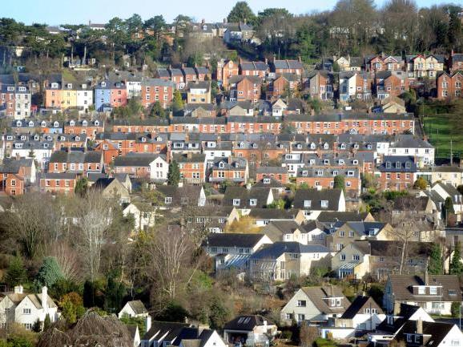
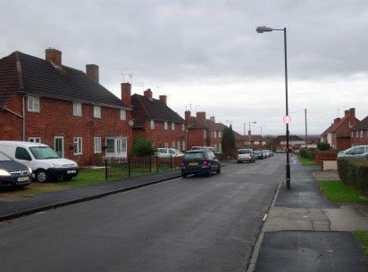
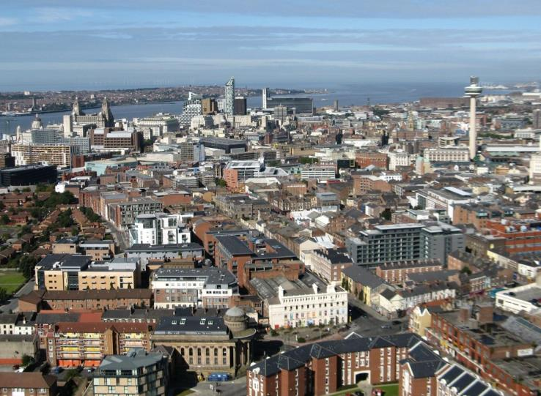
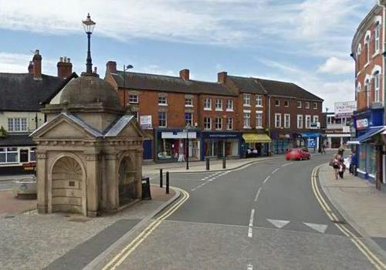
Workshop
Notes:
FOLLOW THE WORKSHOP INSTRUCTIONS ON SHEET PROVIDED.
Read this script to set up the workshop:
“Imagine its 2050. We have cut carbon emissions to nothing and have a stable climate. What have we done to our towns and cities to achieve this in the UK?
How have we adapted our towns and cities to reduce carbon emissions and how have we adapted to the impacts of climate change? What actions have we carried out and what policies do we have in place. Think about your town / village and how and where you live now:
How we generate electricity and heating
How we travel (and how much we travel)
The buildings we live + work in
Where we put housing
Where we put offices
Where we put shops
Please discuss amongst yourselves and write actions onto the flipcharts provided.”

Slide 18
[Insert map of community]
Notes:
Ok, so now we’re going to go from thinking about the world and the uk, to thinking about your community.

Slide 19
Workshop task
“Imagine its 2050. We have cut carbon emissions to nothing and have a safe stable climate. What have we done to achieve this?”
How have we adapted our town/suburb/village to reduce carbon emissions and how have we adapted to the impacts of climate change? What actions have we carried out and what policies do we have in place. Think about your town/village and how and where you live now:
How we generate electricity and heating
How we travel (and how much we travel)
The buildings we live and work in
Where we put housing, offices, shops and services
How we protect biodiversity
How we’ve adapted to extreme weather”
Notes:
Read the script to set up the workshop. FOLLOW THE WORKSHOP INSTRUCTIONS ON SHEET PROVIDED.
Listen to what’s being discussed. If they are struggling, prompt them to think about specific local issues and opportunities in your town or village, for instance if your community is particularly vulnerable to flooding, or sea level rise, is vulnerable to overheating in the summer, or has particular renewable energy assets you could exploit.

Slide 20
Our Buildings | Transport, service provision / location of development
All new development to be zero carbon (highly energy efficient in construction, requiring little to no heating, with zero carbon emissions) | Sustainable patterns of development which minimise the need to travel – new development in locations which are accessible to services on foot, by bike and on public transport
Retrofit existing housing stock (e.g. historic buildings) to radically reduce energy use / carbon emissions and reduce fuel poverty, whilst protecting historic value | Safe, convenient and pleasant walking and cycling routes in new development
Encourage sustainable design + construction in new development – e.g. minimise the use of energy + carbon intensive materials – steel, concrete, glass. | Removing barriers to cycling and walking (existing development) e.g. danger points
All new development to maximise on-site energy generation from renewable sources (e.g. solar panels), with use of on-site electricity storage? | Decarbonise transport – new developments to provide electrical car charging points
Rainwater collection and recycling (greywater systems) to minimise flooding and water use | Maximise local access to services employment + minimise travelling time
 | Measures to support and enable home working
 | Measures to safeguarding local shops + facilities and support local high street – to meet peoples needs near where they live
 | (Related issue) addressing air pollution in urban areas

Slide 21
Energy (electricity and heating) | Resilience to extreme weather / protecting biodiversity
Fossil fuels phased out - 100% of electricity from renewable energy sources - no new homes with gas for heating / cooking | Avoiding areas of future flood risk
Local renewable energy developments maximised – e.g. solar farms, micro hydro, onshore wind, anaerobic digestion. | All suitable development to have sustainable urban drainage systems to manage flooding and provide habitats for wildlife (also delivering cooling effects)
Where possible, community aims to provide all its own electricity from local renewable sources and to own some of its energy supply. | New development to achieve a net benefit in biodiversity and incorporate wildlife habitat
Smart houses incorporating battery or other energy storage to enable intermittent renewable electricity supply (e.g. from solar panels) to be stored to match demand | New developments to be resilient to overheating and heat stress
Stand-alone energy storage to maximise renewable energy potential | New development to incorporate green roofs and walls to manage flooding and heat stress (especially in urban areas)
Maximum exploitation of district heating systems in dense urban areas (District heating = communally provided heat, circulated through insulated underground pipes to multiple buildings) | Tree planting / landscaping to manage heat stress (especially in urban areas) and flood risk, provide habitat and mitigate flooding
 | Safeguarding carbon sinks (e.g. peat bogs) and tree planting for carbon capture
 | Community and local food growing

Slide 22
What can and can’t you have influence over through planning?

Slide 23
What can and can’t you have influence over through planning - summary
What you can influence
The development or use of land where planning permission is needed.
Where new buildings or uses that need planning permission can go.
The design and layout of buildings including drainage.
Transport implications of new development.
Some infrastructure provision (e.g. cycle routes, bus stops etc) where linked to new development and necessary in order to make the development acceptable.
What you can’t influence
Developments which don’t need planning permission.
Spending decisions or actions by other bodies.
How existing buildings are used.
The sale and disposal of land.

Slide 24
Tea break!

Slide 25
Discussion, questions & answers

Slide 26
Thank you
neighbourhoodplanning@cse.org.uk
www.cse.org.uk
@cse_bristol
0117 934 1436 (direct)
0117 934 1400 (switchboard)
This resource has been prepared by the Centre for Sustainable Energy with funding from
the Department for Business, Energy and Industrial Strategy.

