Slide 1


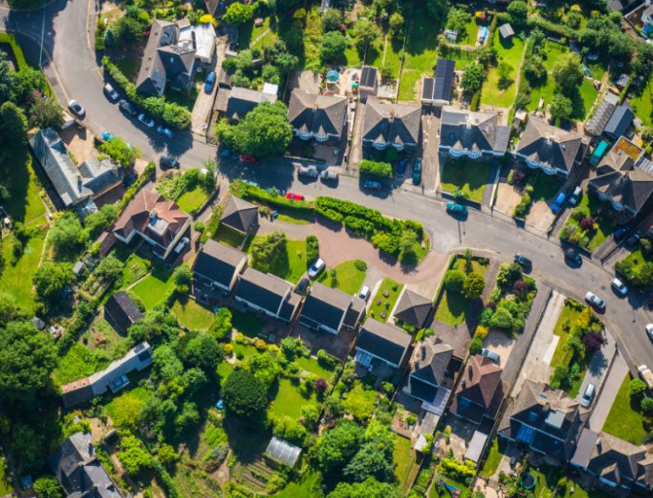
Planning for a zero carbon future

Slide 2
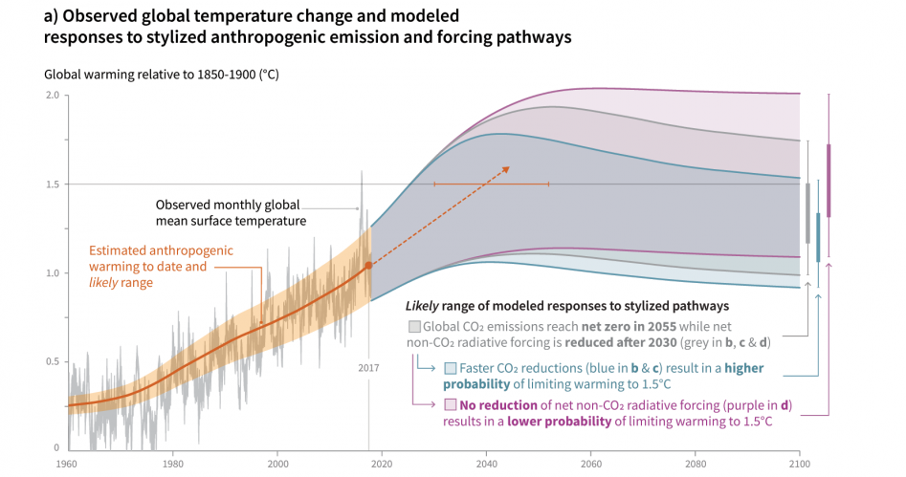
Climate Change: the latest science
Source: https://www.ipcc.ch/sr15/chapter/spm/
Notes:
In 2018 the International Panel on Climate Change released a report on the impacts of 1.5C warming above pre-industrial levels. This graph is taken from that report. The Intergovernmental Panel on Climate Change is an intergovernmental body of the United Nations that is dedicated to providing the world with objective, scientific information relevant to understanding climate change.
The graph shows rising temperatures from 1960 to 2017 (solid orange line) as well as likely range of modelled responses based on different levels of carbon emission reductions. Grey lines shows likely temperature range up to 2100 if global co2 emissions reach net zero in 2055, purple lines shows temperature range if global co2 emissions experience no reduction and the blue line shows temperature range if there is a faster reduction in global co2 emissions.
As the orange line shows so far there has been approximately a 1 degree warming globally since pre-industrial times.
Historically, a temperature increase of 2°C has been seen as a benchmark to prevent climate catastrophe; however this report shows that there is significant differences in the severity of the impacts of climate change under 2C compared to 1.5C. The report suggests that to avoid the most catastrophic impacts of climate change we should therefore aim to stay within 1.5C, however, as the graph shows we are currently on track to reach 1.5C warming by 2030, giving us less than 12 years to act to avoid the most catastrophic impacts of climate change. The report is clear that we are already locked in to a certain amount of global warming which will result in climate impacts but we can avoid the most catastrophic impacts by staying below 1.5C warming.
The report states we will need unprecedented, far reaching and rapid changes across all aspects of our society to achieve this.

Slide 3

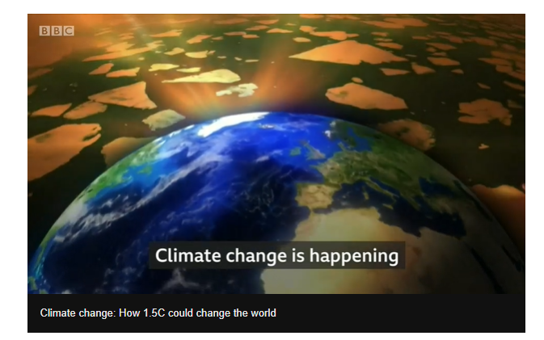
Notes:
{PLAY THIS VIDEO FROM BBC - https://www.bbc.co.uk/news/science-environment-24021772}

Slide 4

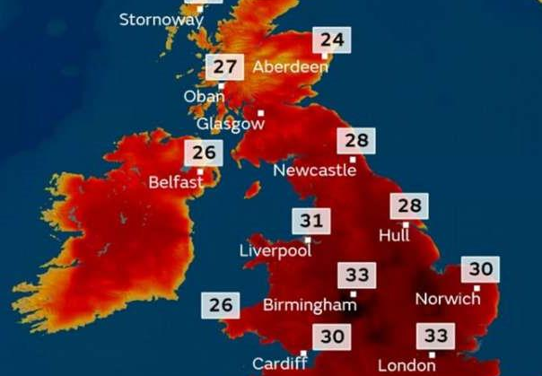
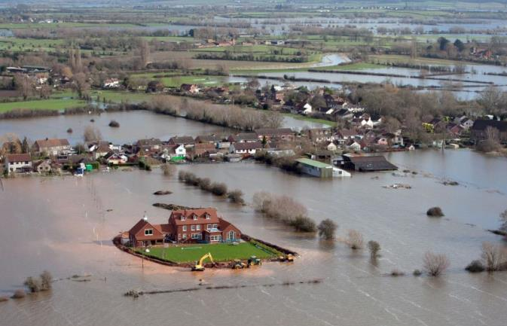
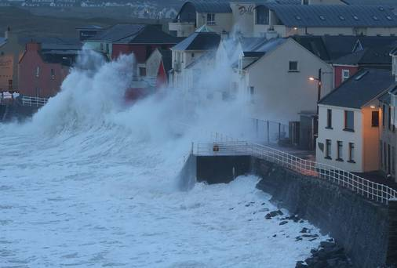
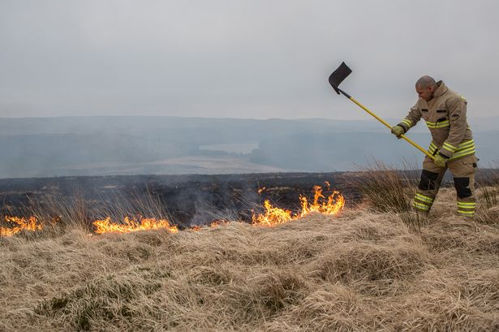
UK Climate Change Impacts
Notes:
So what does this mean for the UK? What climate impacts are we already experiencing and what is the future predicted to look like under un-checked climate change?
Ask this question to the group and wait for suggestions:
Does anyone know which year the top 10 warmest years in the UK have all occurred since?
Beginning with the hottest, the top ten warmest years in sequence are: 2014; 2006; 2011; 2007; 2017; 2003; 2018; 2004; 2002; and 2005. Top 10 warmest years in the UK have all occurred since 2002.
The predictions are that climate change will result in more extreme weather events: with more severe storms, flooding and heat waves, and wetter winters and drier summers, and we’re already seeing this each year.
2018 contained some notable weather events, including the summer heatwave and the Beast from the East, when a record low daily maximum temperature was recorded on 1 March. Despite this particular cold snap, 2018 was on balance a warm year and joins the top ten warmest years at number seven. 2018 was the equal-warmest summer for the UK (along with 2006).
In a business as usual (high emission) scenario, Britain could experience:
summers as much as 5.4°C hotter by 2070 as a result of climate change,
winters could be up to 4.2C warmer,
a 50% chance of summers being as consistently hot as the 2018 summer by 2050,
47% decrease in average summer rainfall by 2070, and up to 35 per cent more rain in winter,
sea level rise of up to 1.15 metres in London by 2100, leaving the UK coastline unrecognizable,
https://www.metoffice.gov.uk/about-us/press-office/news/weather-and-climate/2019/state-of-the-uk-climate-2018
https://www.metoffice.gov.uk/research/approach/collaboration/ukcp/index

Slide 5
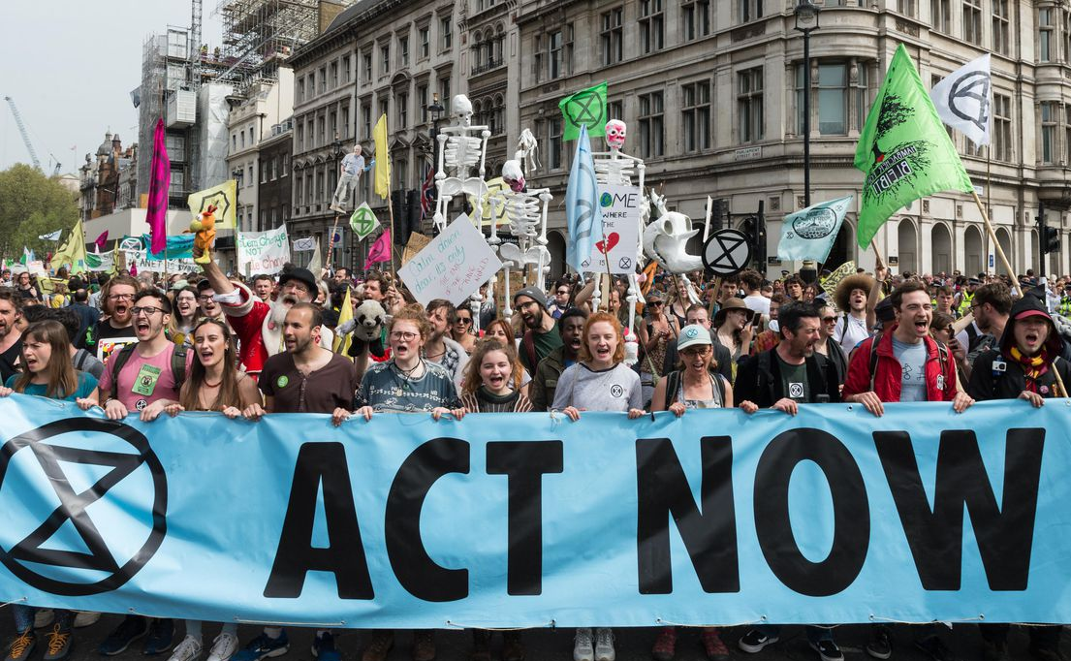
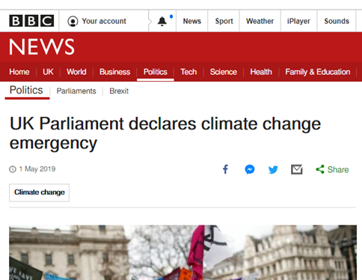
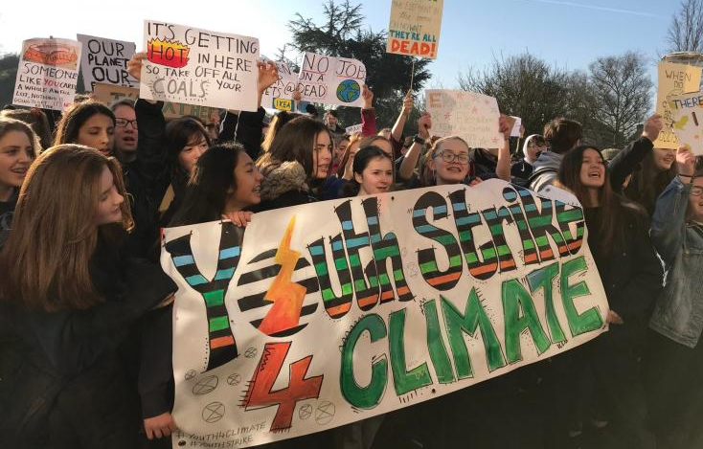

Climate Action and Activism
Notes:
The last few years in both the UK and globally have not only seen an increase in extreme weather events but also an increase in climate action and activism.
Around 300 UK local authorities and a whole host of businesses, hospitals, universities and other organisations have now declared climate emergencies. The UK Government declared an environment and climate change emergency in May 2019 and following this Theresa May, the prime minister at time, committed the UK to net-zero carbon emissions by 2050, superseding the 2008 climate change act which committed to 80% reduction in emissions by 2050. This commitment followed advice from the Committee on Climate Change, an independent non-departmental public body, formed under the Climate Change Act to advise the United Kingdom on tackling and preparing for climate change.
To meet the targets set under the Climate Change Act the government set five-yearly carbon budgets which currently run until 2032. They restrict the amount of greenhouse gas the UK can legally emit in a five year period. The UK is currently in the third carbon budget period (2018 to 2022). The first (2008-12) and second (2013-17) have been met and the UK is on track to meet the third (2018-22) but it is not on track to meet the fourth, which covers the period 2023-27.
We should also not international policy – The Paris Agreement, which was signed in 2016, commits nations to keep global average temperatures “well below 2°C above pre-industrial levels, to pursue efforts to limit the temperature increase to 1.5 °C”, leading to no net increases in carbon emissions in the second half of this century.
In 2018, following the IPCC 1.5C report, Extinction Rebellion (abbreviated as XR), a global environmental movement with the stated aim of using nonviolent civil disobedience to compel government action to avoid tipping points in the climate system, biodiversity loss, and the risk of social and ecological collapse, was established. Hundreds of protests around the world have followed and it has brought climate change centre stage.
2018 also saw the start of a youth climate movement; Youth Strikes 4 Climate. Started by Greta Thunberg, age 15 at the time, who began spending her school days outside the Swedish parliament to call for stronger action on global warming by holding up a sign saying (in Swedish) "School strike for the climate". This has now spread into a global movement with 1.4 million students in over 100 countries taking to the streets in organised strikes to make their voices heard.
To summarise a few key take away points:
Climate Change is happening faster and with more severe impacts than we thought,
We aren’t meeting the carbon reduction targets we already have in place, and much faster reductions are needed,
So government needs all the help it can get.

Slide 6
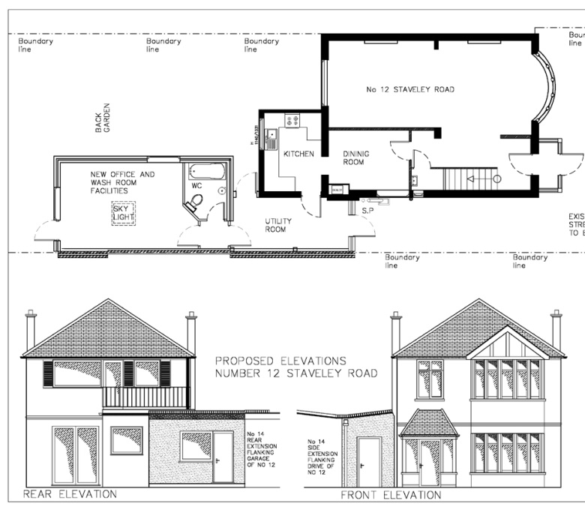
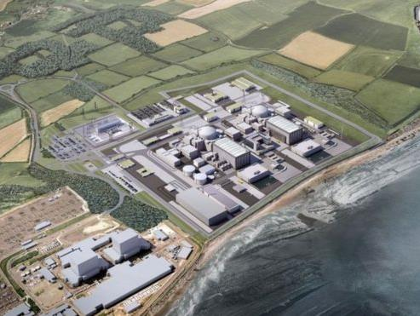
How planning works
Notes:
The Planning system has huge potential to address the climate crisis and reduce carbon emissions. Nearly all development, from a house extension to a nuclear power station needs planning permission. Through influencing what goes ahead, where new buildings are built, how they are built and planned, emissions can be reduced and the impacts of climate change can be lessened.
From house extensions to nuclear power stations, the process is essentially the same. A planning application is submitted, with drawings and details of what is proposed and the public is consulted. The planning application is then assessed against National Planning Policy, set by the UK Government, and Local Planning policies – “Local Plan” written by councils.
The application is then approved or refused. The planning process is hugely important, in that what is built where and how we build it influences how much CO2 we emit and how vulnerable we are to impacts of climate change.

Slide 7
Local Plan and Neighbourhood Plan
National Planning Policy Framework
Set by the UK Government
Sets out government's planning policies for England
Local Plan
Prepared by Local Planning Authority (local council) or national park authority
Guides decisions on future development proposals and addresses needs of the area
Neighbourhood Plan
Developed by communities
No particular requirements but do have to comply with some basic conditions
Once adopted, neighbourhood plan policies have the same importance as your council’s planning policies.
Notes:
Local plans are prepared by the Local Planning Authority (LPA), usually the Council or the national park authority for the area.
The Local Plan guides decisions on future development proposals and addresses the needs and opportunities of the area. Topics that Local Plans usually cover include housing, employment and shops and they also identify where development should take place and areas where development should be restricted.
The Local Plan must contribute to the achievement of sustainable development and be consistent with the principles and policies in the government’s National Planning Policy Framework. In essence, the Local Plan should set out what the opportunities are for development in the area, and say what types of development will and will not be permitted and in which locations.
Neighbourhood plans enable communities to set their own planning policies to control development which happens within their areas. Once adopted, these policies have the same importance as those set by your council.
There are no particular requirements that neighbourhood plans have to include, but they do have to comply with some basic conditions.
Neighbourhood plans are therefore a huge opportunity for communities to develop policies and strategies addressing climate change, to add to or fill gaps in what local council’s are already doing.

Slide 8
Workshop task
“Imagine its 2050. We have cut carbon emissions to nothing and have a safe stable climate. What have we done to achieve this?”
How have we adapted our town/suburb/village to reduce carbon emissions and how have we adapted to the impacts of climate change? What actions have we carried out and what policies do we have in place. Think about your town/village and how and where you live now:
How we generate electricity and heating
How we travel (and how much we travel)
The buildings we live and work in
Where we put housing, offices, shops and services
How we protect biodiversity
How we’ve adapted to extreme weather”
Notes:
Ok, so now we’re going to go from thinking about the world and the UK, to thinking about your community.
Read the script to set up the workshop. FOLLOW THE WORKSHOP INSTRUCTIONS ON SHEET PROVIDED.
Listen to what’s being discussed. If they are struggling, prompt them to think about specific local issues and opportunities in your town or village, for instance if your community is particularly vulnerable to flooding, or sea level rise, is vulnerable to overheating in the summer, or has particular renewable energy assets you could exploit.

Slide 9
What can and can’t you have influence over through planning?
What you can influence
The development or use of land where planning permission is needed.
What you can’t influence
Developments which don’t need planning permission.
Where new buildings or uses that need planning permission can go.
The design and layout of buildings including drainage.
Transport implications of new development.
Some infrastructure provision (e.g. cycle routes, bus stops etc.) where linked to new development and necessary in order to make the development acceptable.
Spending decisions or actions by other bodies.
How existing buildings are used.
The sale and disposal of land.
Notes:
Read through bullet points on slide.

Slide 10


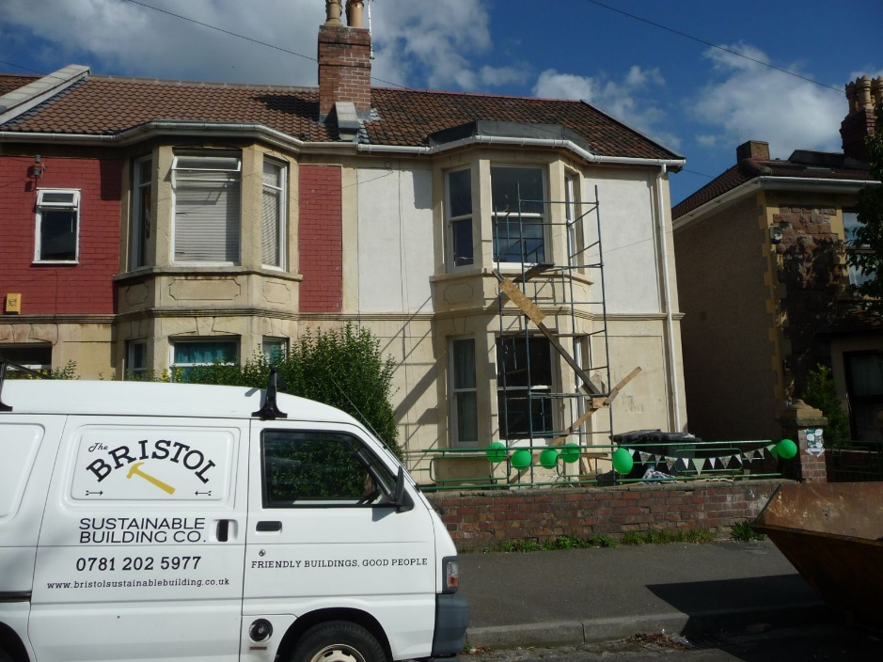
Buildings
all new development to be zero carbon (highly energy efficient, requiring little to no heating, with zero carbon emissions)
All existing housing stock (e.g. historic buildings) need to be retrofitted to radically reduce energy use / carbon emissions and reduce fuel poverty, whilst protecting historic value
sustainable design + construction - new development needs to minimise the use of energy + carbon intensive materials – steel, concrete, glass
new developments to maximise on-site energy generation from renewable sources (e.g. solar panels)
rainwater collection and recycling to minimise flooding and water use
Notes:
Explain that you are now going to share some ideas on planning for a zero carbon future. Ensure that you give them the opportunity to edit or revise the list of ideas you present and ask questions.
Looking at our buildings first:
To tackle climate change and reduce carbon emissions to ensure we stay within 1.5C of warming …
all new development need to be zero carbon (highly energy efficient in construction, requiring little to no heating, with zero carbon emissions)
existing housing stock (e.g. historic buildings) need to be retrofitted to radically reduce energy use / carbon emissions and reduce fuel poverty, whilst protecting historic value
sustainable design + construction in new development needs to be encouraged – e.g. minimise the use of energy + carbon intensive materials – steel, concrete, glass
all new developments need to maximise on-site energy generation from renewable sources (e.g. solar panels)
rainwater collection and recycling (greywater systems) should be considered to minimise flooding and water use

Slide 11
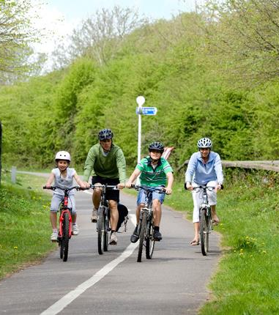
Transport
Sustainable patterns of development which minimise the need to travel – new development in locations which are accessible to services on foot, by bike and on public transport
Safe, convenient and pleasant walking and cycling routes in new developments
Removing barriers to cycling and walking (existing development) e.g. danger points
Decarbonise transport – new developments to provide electrical car charging points
Measures to safeguarding local shops + facilities and support local high street – to meet peoples needs near where they live
Notes:
For transport:
Sustainable patterns of development which minimise the need to travel – new development in locations which are accessible to services on foot, by bike and on public transport
Safe, convenient and pleasant walking and cycling routes in new developments
Removing barriers to cycling and walking (existing development) e.g. danger points
Decarbonise transport – new developments to provide electrical car charging points
Measures to safeguarding local shops + facilities and support local high street – to meet peoples needs near where they live
Questions to ask are….
How do you currently travel to school?
How would you prefer to travel to school?
What is preventing you from travelling to school in this way?

Slide 12
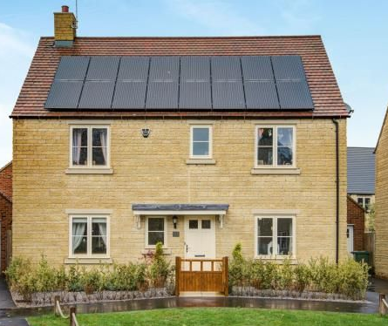
Energy
Fossil fuels phased out - 100% of electricity from renewable energy sources - no new homes with gas for heating / cooking
Local renewable energy developments maximised – e.g. solar farms, micro hydro, onshore wind, anaerobic digestion.
Where possible, community aims to provide all its own electricity from local renewable sources and to own some of its energy supply.
Smart houses incorporating battery or other energy storage to enable intermittent renewable electricity supply (e.g. from solar panels) to be stored to match demand
Maximum exploitation of district heating systems in dense urban areas (District heating = communally provided heat, circulated through insulated underground pipes to multiple buildings)
Notes:
For energy (electricity and heating):
Fossil fuels phased out - 100% of electricity from renewable energy sources - no new homes with gas for heating / cooking
- Local renewable energy developments maximised – e.g. solar farms, micro hydro, onshore wind, anaerobic digestion.
- Where possible, community aims to provide all its own electricity from local renewable sources and to own some of its energy supply.
- Smart houses incorporating battery or other energy storage to enable intermittent renewable electricity supply (e.g. from solar panels) to be stored to match demand
- Maximum exploitation of district heating systems in dense urban areas (District heating = communally provided heat, circulated through insulated underground pipes to multiple buildings)
Questions to ask are:
Has anyone seen a wind turbine or solar panel?
Does anyone have any in their homes?
How would you feel if there were more in your local area?

Slide 13
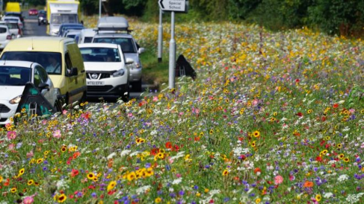
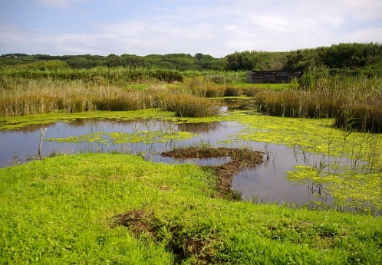
Resilience to extreme weather / protecting biodiversity
Avoid areas of future flood risk
All suitable development to have sustainable urban drainage systems to manage flooding and provide habitats for wildlife (also delivering cooling effects)
New development to achieve a net benefit in biodiversity and incorporate wildlife habitat
New developments to be resilient to overheating and heat stress
New development to incorporate green roofs and walls to manage flooding and heat stress (especially in urban areas)
Tree planting / landscaping to manage heat stress (especially in urban areas) and flood risk, provide habitat and mitigate flooding
Safeguarding carbon sinks (e.g. peat bogs) and tree planting for carbon capture
Community and local food growing
Notes:
For extreme weather resilience and protecting biodiversity:
- Avoid areas of future flood risk
- All suitable development to have sustainable urban drainage systems to manage flooding and provide habitats for wildlife (also delivering cooling effects)
- New development to achieve a net benefit in biodiversity and incorporate wildlife habitat
- New developments to be resilient to overheating and heat stress
- New development to incorporate green roofs and walls to manage flooding and heat stress (especially in urban areas)
- Tree planting / landscaping to manage heat stress (especially in urban areas) and flood risk, provide habitat and mitigate flooding
- Safeguarding carbon sinks (e.g. peat bogs) and tree planting for carbon capture
Community and local food growing
Questions to ask are:
What kind of animals do you see in your gardens and parks?
What green spaces do you value in your local area?

Slide 14
Your Neighbourhood Plan
Insert logo or photo of your Neighbourhood Plan
Notes:
Summarise what they’ve learnt about climate change, the changes they have suggested for the area and reiterate that their ideas will influence the local neighbourhood plan and what the area looks like in the future. Let them know how they or their parent/guardian(s) can get involved with their Neighbourhood Plan and attend meetings etc.
Introduce the materials/handouts (examples attached) to go out to their parents.

